Slide 1
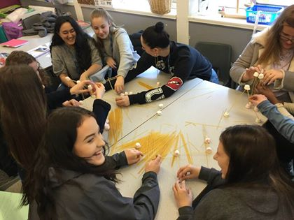

Childcare and Education
Welcome
Summer Activity Pack
for year 11 students progressing to SCG

Slide 2
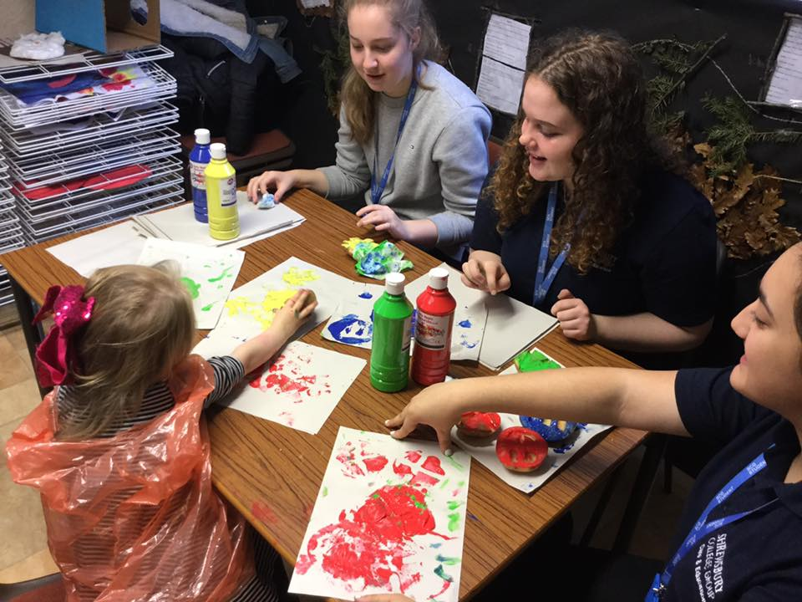
Contents
Welcome
Would you rather?
All about me
Kahoot: child development
  Kahoot: fancy words (key terminology)
  Role of the Childcare Practitioner and word cloud
  Placements- research and create a factsheet on two places you would like to go
  Coronavirus- activities for families
  Student voice
  Student images
  Enrolment and DBS
Video Q&A-
  School children
  Nursery age
  Baby
Bring this complete activity book with you when you start college as we will be using it in induction week.

Slide 3
Meet the Childcare Team
Chris Greensall
Level 3 course leader : Early Years Educator
chrisg@shrewsbury.ac.uk
Sturcha Wynn Hi, I am the level 2 course leader for: Early years Practitioner and Teaching Assistant qualifications
sturchaw@shrewsbury.ac.uk
Teresa Spiers
Level 1 course leader: Health, social care and child care.
theresas@shrewsbury.ac.uk
Sue Williams
Childcare Lecturer
Karen Kearns
Childcare
Assessor

Slide 4
What this years students said…
What I enjoyed about the course was going to placement as I feel like I really got to experience what it’s like working in a school and plus the staff at my placement were also really helpful when it came to any placement work. My advice to new students would be to make sure to keep on top of your coursework and try to stick to deadlines as best they can. Esme
I enjoyed all of this course it has taught me so much and I have gained a wider knowledge and experience of what it is like to be a Teaching Assistant. My favourite thing was having the opportunity to go into a placement 2 days a week and gain more experience. My advice would be to enjoy it, but to also make sure you meet the assignment hand in dates. Katie
I have enjoyed how this course pushed me to become a better person. I've learnt so much and I believed I could never do it but I did. Stay calm and ask for support when you need it and you get it, your going to do great study hard and be organised. Caitlin
I liked going to placement as I got to put the skills that I had learnt into practice. I would recommend that they you get the textbook as it was so much help when it came to the coursework. I am progressing onto level 3 in September. Tiegan
Placement is very enjoyable and not as terrifying as you may think, finish your work as early as you can and don't be worried to ask for help. Daniel
The making of story sacks and making activities for placement was good. Lots of support in college which has really helped me develop. Kaci

Slide 5
Would you rather?
Type A or B in the box for your answer
Would you rather
A) care for a 9 months old baby
B) care for a five year old child?
Would you rather
A) work in a nursery
B) work in a school
Would you rather
A) change a nappy
B) clean up baby vomit
Would you rather
A) clean out paint pots
B) clean the nursery kitchen
Would you rather
A) play in the sand with children
B) make mud pies
Would you rather
A) write an essay
B) create a interactive poster
Would you rather
work on your own
work in a small group
Would you rather
use the course book
use the internet
Would you rather
A) support playground duty
support snack duty
Would you rather get covered in
A) glue
B) paint

Slide 6


Selfie
Happy things:
I am proud of:
Things I love:
Things I care about:
D.O.B
My family
My goals this year:
Favorite read:

Slide 7

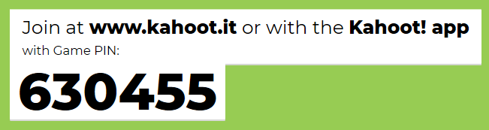

Quiz on child development

Slide 8
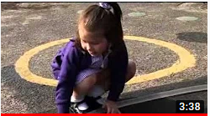

Watch the video and have a go at answering the questions
www.youtube.com/Playing Fire Fighters on the Playground
Describe what the children are doing.
Summarise what the children are learning.
Conclude the role of the practitioner.

Slide 9
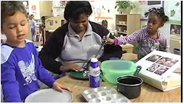
Watch the video and have a go at answering the questions
www.youtube.com/Supporting Play Eating Play dough Snakes
Describe what the children are doing.
Summarise what the children are learning.
Conclude the role of the practitioner.

Slide 10
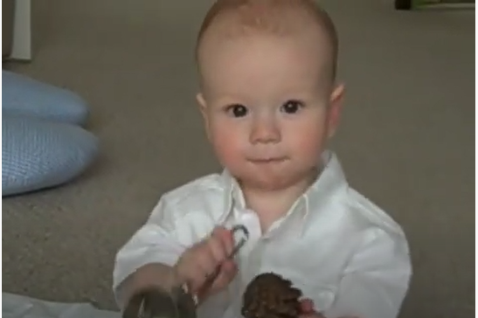
Watch the video and have a go at answering the questions
www.youtube.com/ Georges Heuristic Play with a Treasure Basket
Describe what the George is doing.
Summarise what George may be learning.
Conclude the role of the practitioner.
What object would you add to the treasure basket for George to investigate? Explain your choice.

Slide 11

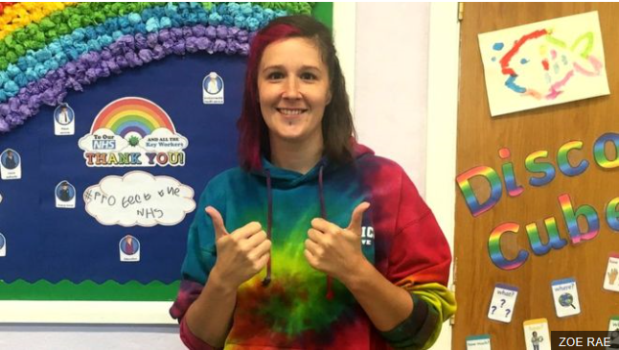


Can you suggest activities families can do at home with their children who can not attend nursery or school due to coronavirus lockdown.

Slide 12
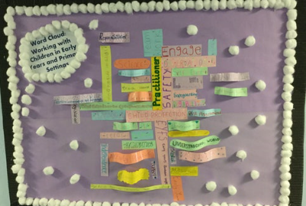


Fancy words

Slide 13
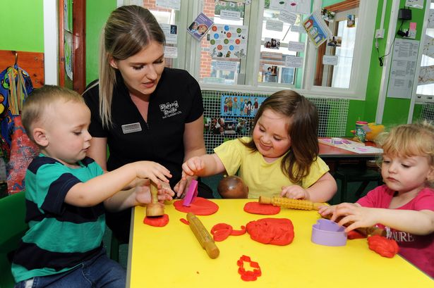


Role of the Childcare Practitioner
Choose a job description, read, make notes, highlight and create your own word cloud of key attributes and skills a practitioner needs to have. Use the next slide.
The Wishing Tree Nursery/Job-Description-Nursery-Practitioner
www.theschoolrun.com/Job Description -teaching-assistant

Slide 14

My word cloud

Slide 15

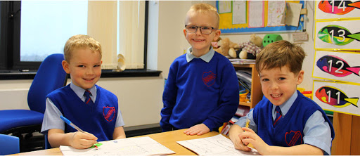
Research and produce a factsheet on 2 places you would like to go to on placement. You can then share this information with the Placement Officers

Slide 16


DBS
SCG pay for your DBS check
www.gov.uk/DBS /documents-the-applicant-must-provide
Supporting documents
To enroll you must bring 2 documents from any of the groups listed: 1, 2a and 2b.
Otherwise you will not be able to enroll on your childcare course as we regard safeguard children and yourselves with great importance.

Slide 17
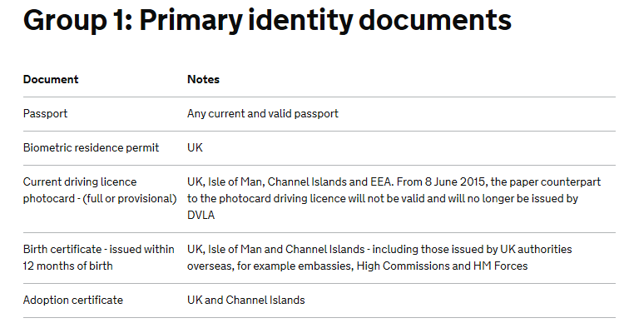

Slide 18
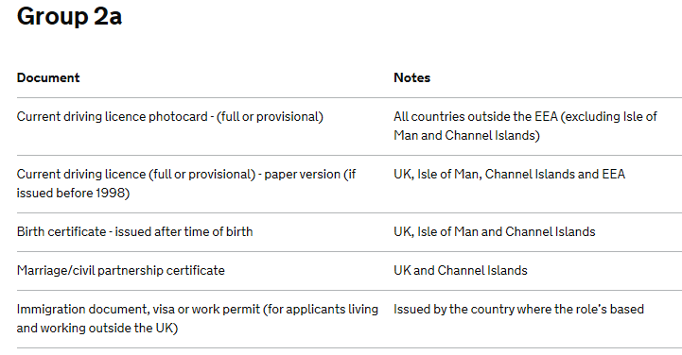

Slide 19
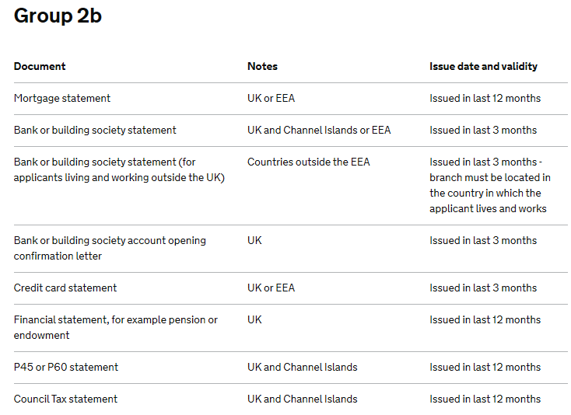
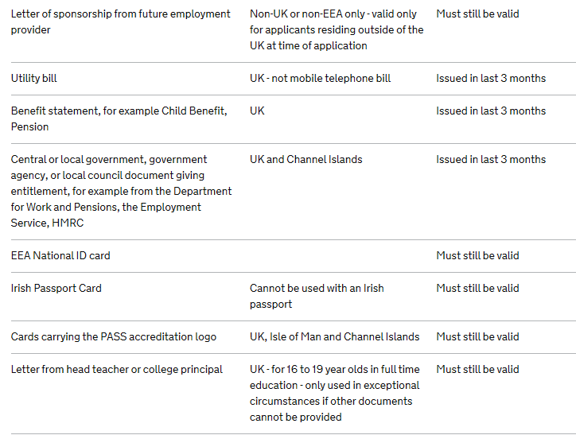

Slide 20
Enrolment checklist
The 2 types of ID I am going to bring are:
1-
2-
Exam results
School report
Address and contact numbers
Money to buy a placement polo shirt costing £8.50

Slide 21
What this years students said…
Saskia
Keep up to date with everything, do some of the work at home to make it easier for yourselves, and it’s not only course work it’s fun you make new friends and you learn new skills all the time. My tutor also nominated me for the High Sheriff Award for my charity work and I won the county shield.
Tilly
I have really enjoyed making new friends on the course . I enjoy taking part in practical activities like having the babies, making play dough and making story sacks.
Livvy
I have enjoyed how relaxed the lessons are, if I do feel stressed the teachers are so easy to make contact with and help!! There is so much support too! The course as a whole was enjoyable and the activities were enjoyable and didn’t feel like work but I was still learning. Some advice is to make sure you are on top of your work and ask for help if needed!!! Try not to fall behind. I am really happy to be progressing onto level 3 Early Years Educator in September.

Slide 22

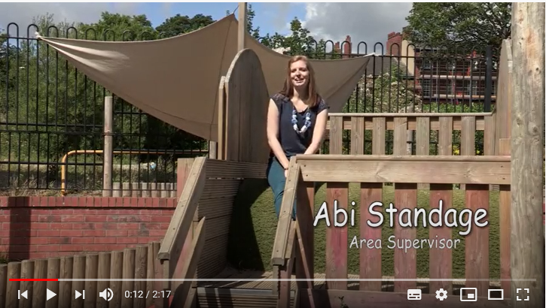
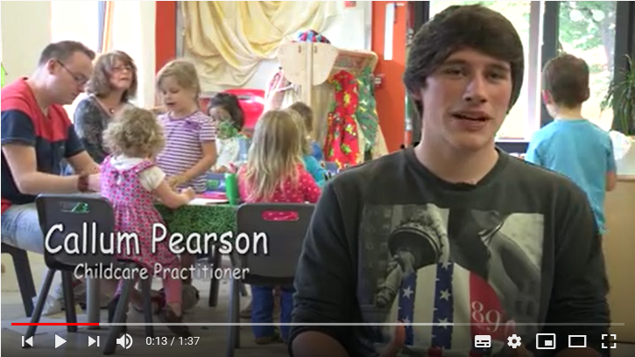
Careers working with children
Qualified to work as a:
Early Years Educator
Portage home visitor
Nanny
Teaching assistant
Special Educational Needs Teaching Assistant
Play worker
Play therapist
Family worker
Creche worker
Childminder
Progress to work as a:
Primary teacher
Ofsted inspector
Nursery manager
Welfare officer
Social worker
Further education lecturer
www.cache.org.uk/for-learners/careers-help
https://nationalcareers.service.gov.uk/ Early Years

Slide 23
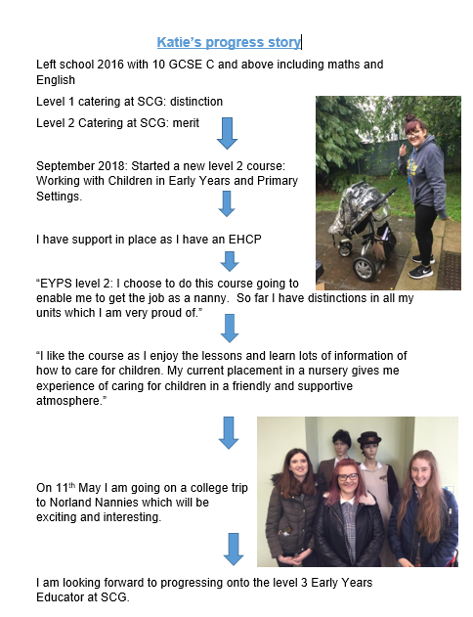
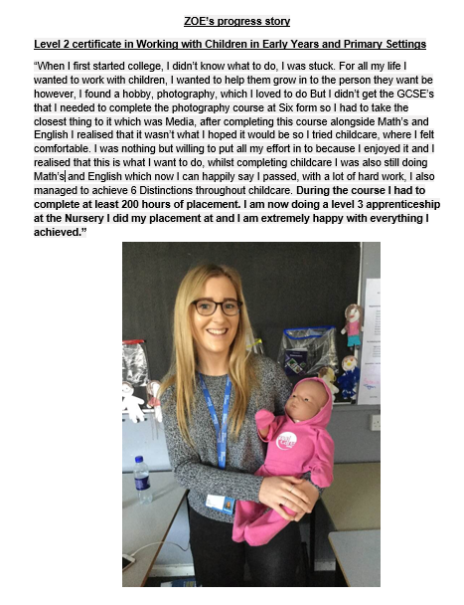
Students progression stories

Slide 24
What is your progression story so far?

Slide 25

Have a great summer, hopefully you will all get time with your family and friends. The childcare team Chris, Sturcha, Teresa, Sue and Karen look forward to welcoming you to SCG college very soon.
Bring this complete activity booklet with you when you start college as we will be using it in induction week.
Thank you

